Slide 1
Promoting Active and Healthy Ageing at the local level in Georgia
Lela Bakradze, Society for Social Rigths in Georgia
Notes:
I would like to share an example from Georgia, where until recently, before my retirement in 2024, I served as a Head of the UNFPA Office.

Slide 2
Loneliness and Social Isolation among Older People UNFPA EECARO & UCL, UK, 2022
  Loneliness - a major risk factor for age-related health problems and diseases
  79% of older people (aged 65–85) experience at least moderate loneliness
  18% report extreme loneliness
  Among contributing factors in Georgia:
  lack of physical support (25%),
  limited number of social connections (27%),
  unmet desire for additional social interaction (13%),
  insufficient mental health support (16%)
Notes:
When discussing well-being of older persons, Loneliness and social isolation among the elderly population represent particularly acute challenges. Loneliness is not only emotionally distressing but also a major risk factor for age-related health problems and diseases. Evidence shows that loneliness carries a mortality risk comparable to that of regular tobacco use or obesity.
in Georgia
Emotional loneliness is more prevalent among older persons than social loneliness - majority of them (52%) consider themselves emotionally more or less lonely; that is, they complain about the absence of persons with whom they would share their feelings and would have something in common/ 45% of respondents consider themselves socially more or less lonely; that is, these people complain about the absence of a social network, which consists of a circle of close family and friends.
whereas 28% of respondents report feeling severe emotional loneliness, only 16% of respondents report feeling the same degree of social loneliness. It appears that older persons in Georgia are not so much worried about the lack of people around them, but the lack of sharing emotions with these people.
The research conducted by UCL-UNFPA in several countries of the EECA region, including Georgia, has indicated that 79% of older people (aged 65–85) experience at least moderate loneliness, while 18% report extreme loneliness.

Slide 3
Recommendations
  Reinforce programs that promote active ageing, lifelong learning, and volunteering, keeping older people socially engaged and mentally/physically healthy.
  Support establishment of community day centers and similar facilities for older people, where group activities can be organized, and older adults can gather, connect and receive the support they need to lead healthier, more fulfilling lives.
.
Notes:
One effective and cost-efficient way to address multiple risk factors at once is to introduce regular, targeted group activities for older adults. Such activities—ranging from learning digital skills and social communication techniques to fostering positive social attitudes—strengthen social connections, provide physical and emotional support, enhance spiritual well-being, and build trust within communities.
Hence, one of the key recommendation is the establishment of community day centers and similar facilities for older people, where group activities can be organized, and older adults can gather, connect, and receive the support they need to lead healthier, more fulfilling lives.

Slide 4

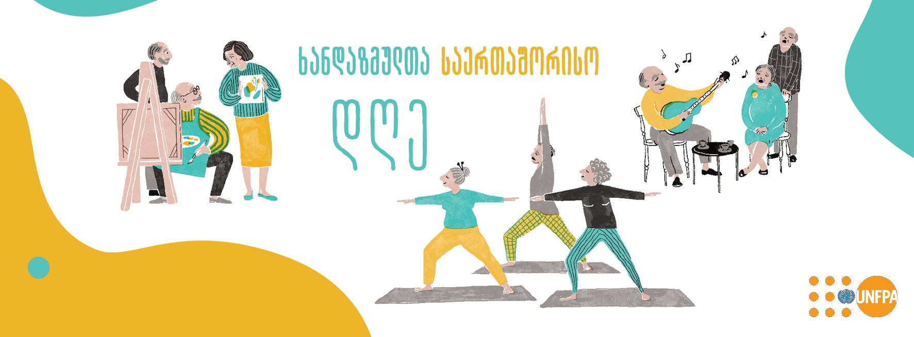
Municipal Service – 60+ Clubs for Healthy and Active Life
Notes:
“60+ Club for Healthy and Active Life” is an initiative of the United Nations Population Fund, which it implements together with local municipalities since 2019.
Based on the Handbook for establishing and managing the Clubs for Healthy and Active Life, which was developed in 2019

Slide 5

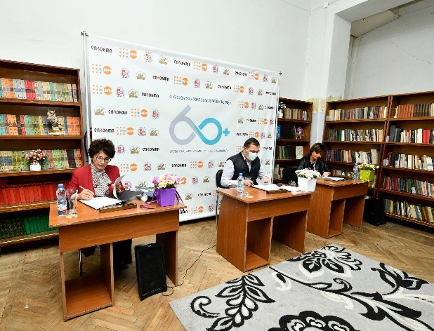
Municipal Service – 60+ Clubs for Healthy and Active Life
UNFPA initiative based on the best international experience, including in BiH;
UNFPA advocated for and provided technical assistance in launching 60+Clubs; supported study visits in BiH;
Since day one Clubs are fully funded by City Municipalities; as of 2025 – four 60+ Clubs operate in three cities in Georgia;
Collaboration is based on the MoU: UNFPA provides technical assistance, mobilizes partnerships with private sector and donors, supports awareness raising activities to promote healthy and active ageing, overcome stigma related to ageing and older persons, and to foster a positive image of ageing in the society.
Notes:
Four clubs operate in three municipalities, offering older people spaces for active living, health promotion.

Slide 6
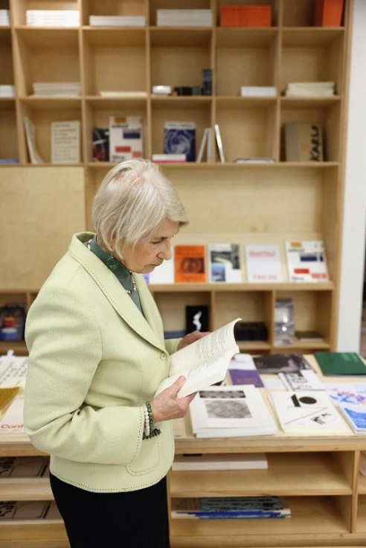
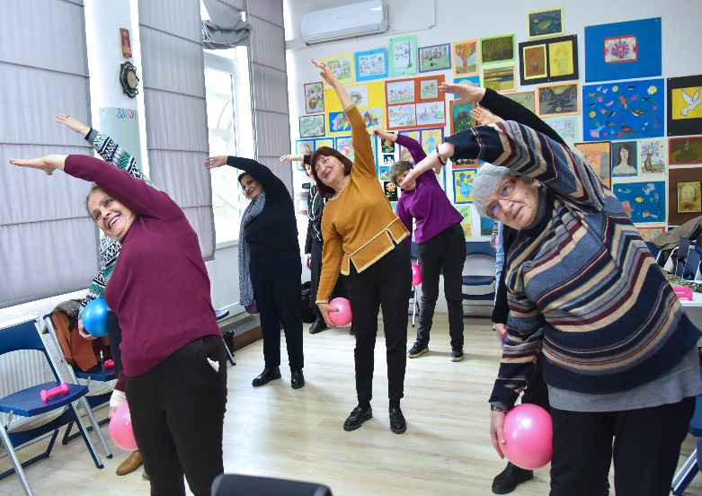
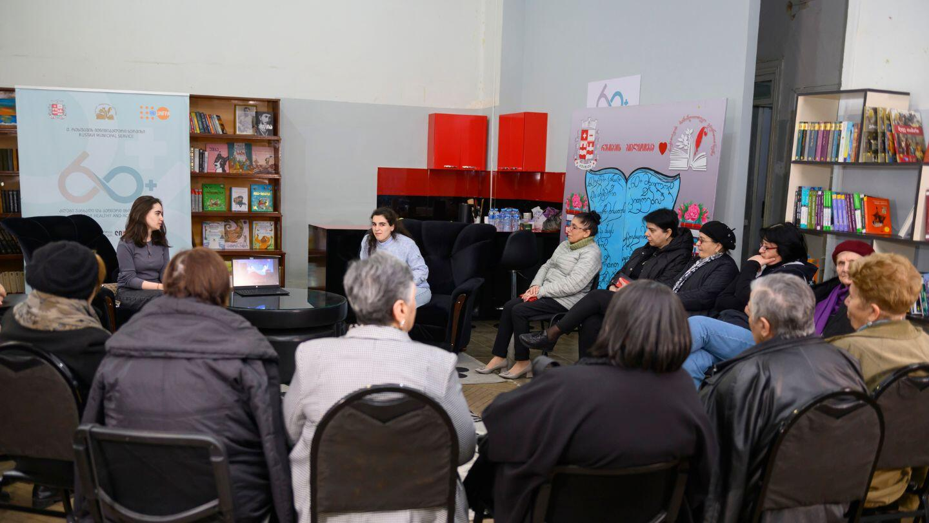
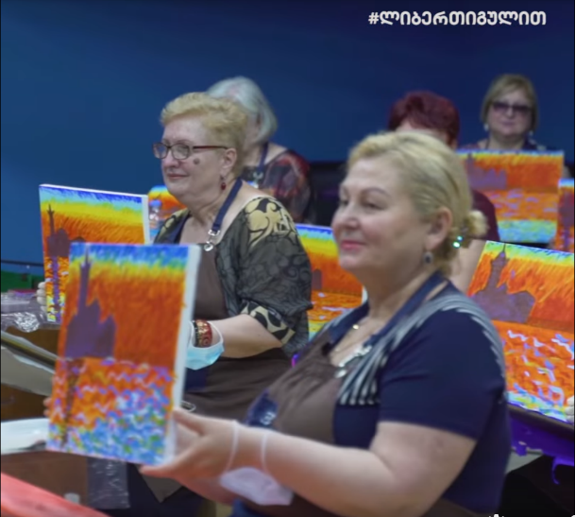
Municipal Service – 60+ Clubs for Healthy and Active Life
Membership-based club, a socialization space for older people
Opportunity to learn new skills with their peers, share their experiences, plan and organize various events themselves, and get acquainted with new information and ideas.
The club is aimed to become a regular part of the life and social process of older people
Notes:
It is a membership-based club, a socialization space for older people, which aims to create a harmonious and diverse environment to promote an active and healthy life.
Club members are given the opportunity to learn new skills with their peers, share their experiences, plan and organize various events themselves, and get acquainted with new information and ideas.
The club promotes the process of active and healthy aging, when older people maintain their health, are full members of society, more independent in everyday life and more involved as citizens.
The club is aimed to become a regular part of the life and social process of older people; membership in the club should be a source of pride, and the emergence of new acquaintances and social circles should be joyful.

Slide 7
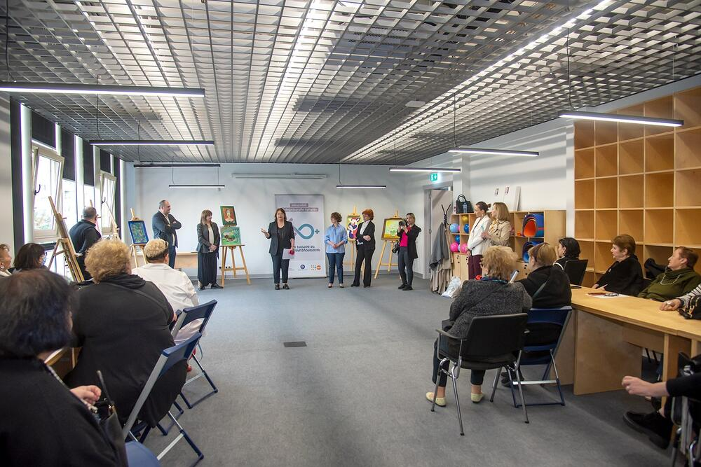
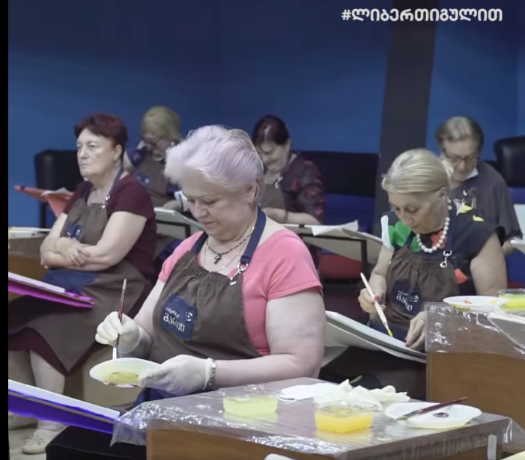
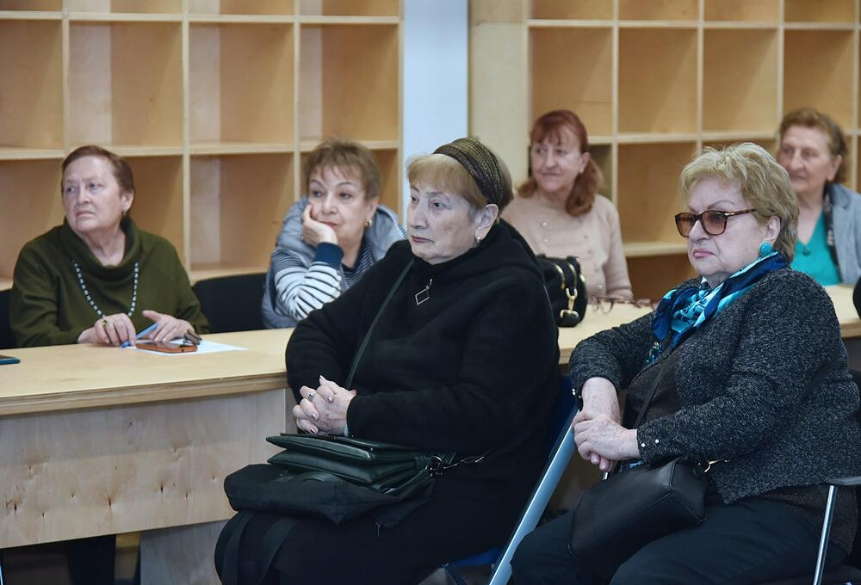
Municipal Service – 60+ Clubs for Healthy and Active Life
Advisory Board aims to provide the club and its leaders with the necessary support, advice and assistance;
● Advisory Board ensures the Club's connection with individuals or organizations that can sponsor the club, make donations, or otherwise provide assistance to the club;
● The Board meets once / twice a year.
Notes:
The function of the Advisory Board is to provide the club and its leaders with the necessary support, advice and assistance;
● Possible member organizations and institutions: local self-government apparatus, municipal mayor's office, public health center, local and/or central agency working in the field of social and health care, pensioners' association, educational institutions, representatives of private business organizations, etc.;
● Representatives of the Advisory Board, with their extensive connections, ensure the club's connection with individuals or organizations that can sponsor the club, make donations, or otherwise provide assistance to the club;
● A meeting of the board members is held once / twice a year, where the club leader presents the board with current information about the center's activities and the strategic plan and vision for the next period.

Slide 8
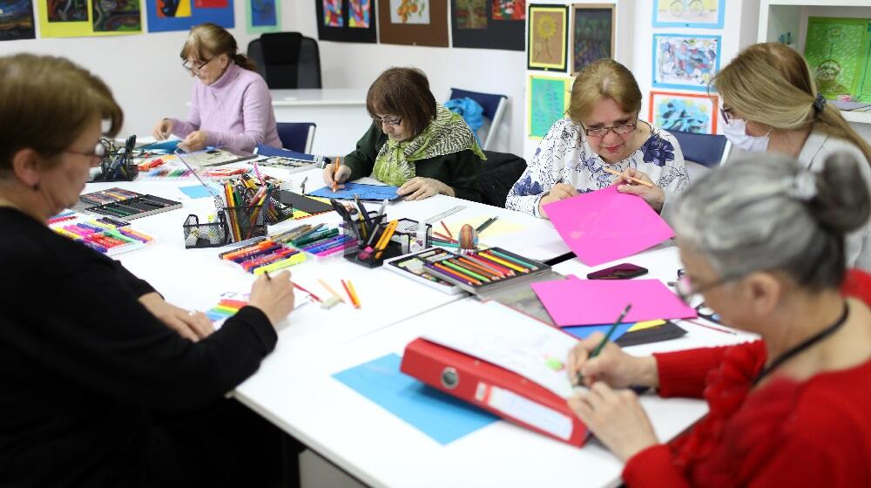
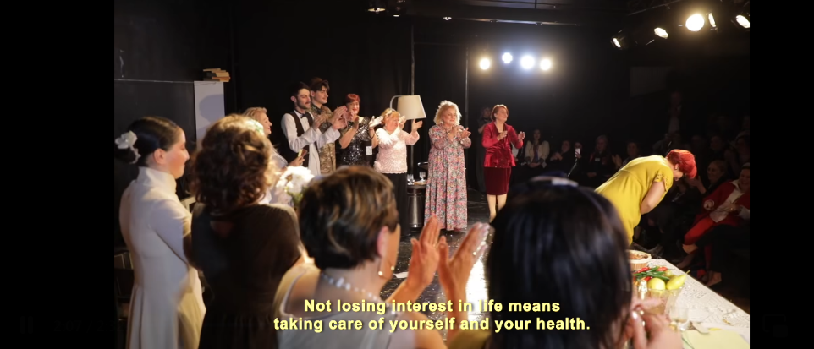
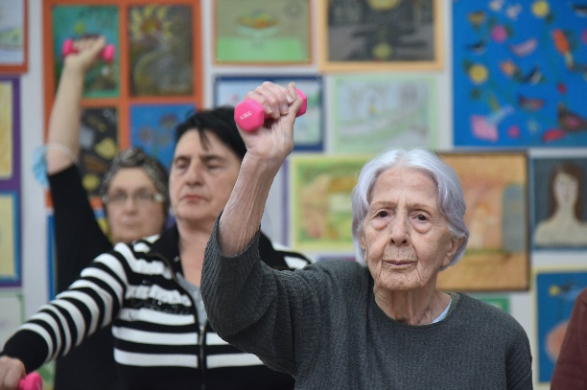
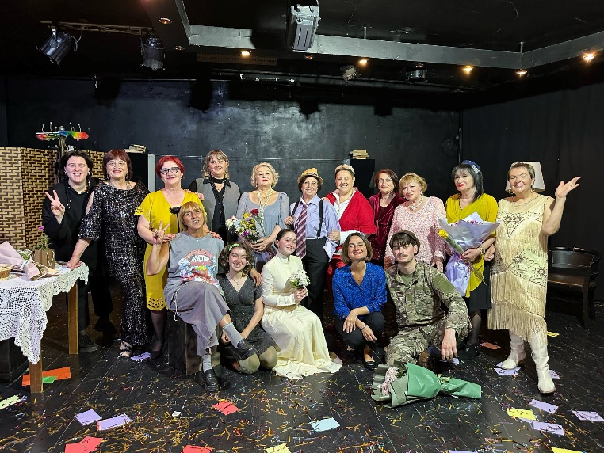
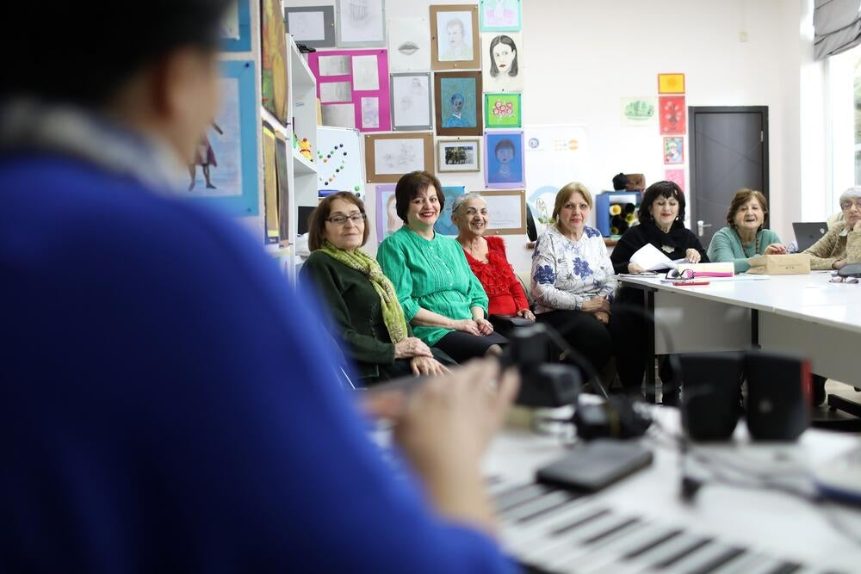
Municipal Service – 60+ Clubs for Healthy and Active Life
The activities of the 60+ Clubs include: therapeutic physical exercises (under the supervision of a specialist), foreign language and computer/IT literacy lessons, sports and intellectual games, art circles and workshops, and culinary sessions.
The program is based on international standards and takes into account the experience of a number of countries, including BiH.
Notes:
A play based on Eduardo De Filippo’s comedy Fear No. 1 was recently staged in the the Kutaisi Professional State Drama Theater. The production brought together members of the “60+ Club” and young actors, showcasing an inspiring example of intergenerational collaboration in the arts.
According to one of the club members, “The 60+ Club is a place where people do not lose interest in life or in themselves. It gives us the opportunity to discover hidden talents, develop them, and realize dreams we once thought were unattainable.”

Slide 9
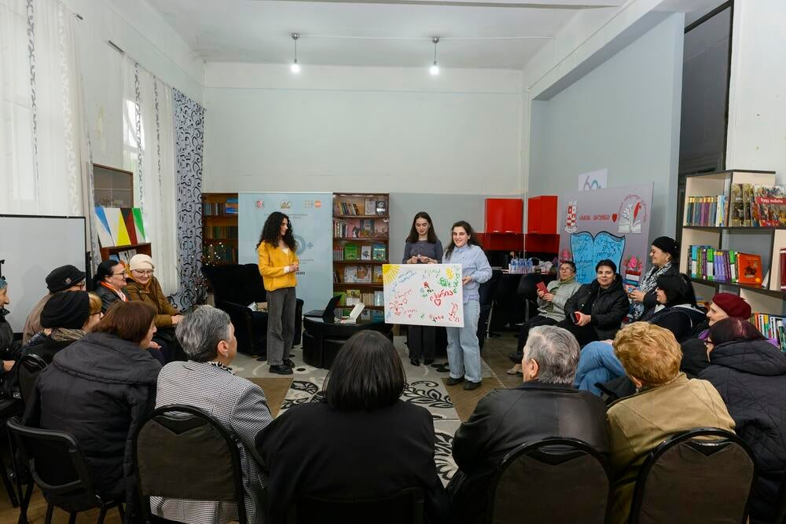
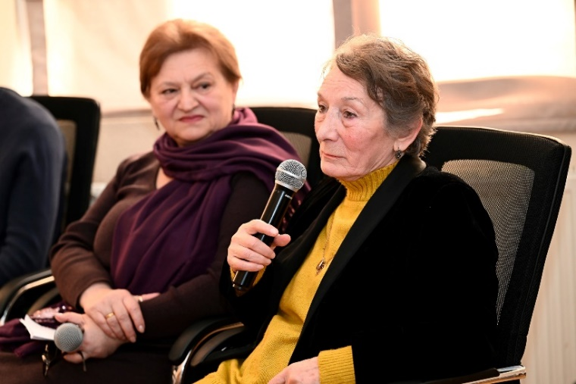
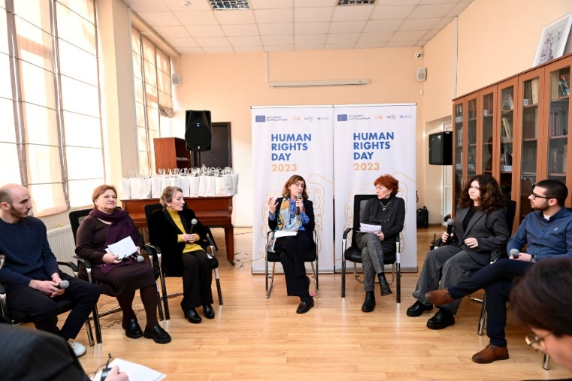
60+ Clubs – a Space for Intergenerational Dialogue
UNFPA launched series of intergenerational dialogues that brought together older persons and youth to explore common interests and challenges.
Aim: Connecting generations, sharing experiences, fostering generational learning and a sense of collective reflection
Topics:
Human Rights
Gender roles and stereotypes within the family
Notes:
Within these clubs, UNFPA recently launched a series of intergenerational dialogues that brought together older persons and youth to explore common interests and challenges.
the first dialogue, held in Tbilisi, was focused on human rights. It was a powerful moment—when older people, often marginalized from public conversations, voiced their views alongside youth. The presence of the Deputy Public Defender of Georgia underscored the importance of these exchanges.
A second dialogue took place in Rustavi this year, initiated by a youth group. It tackled gender roles and stereotypes within the family—a topic that both generations were eager to discuss. The participants find this initiative deeply enriching: shared experiences, generational learning, and a sense of collective reflection.
These initiatives show that connecting generations is not a luxury—it is a necessity. It is key to building communities that include all ages and are resilient in the face of the social, economic, and demographic challenges ahead.

Slide 10
THANK YOU!

